Slide 1
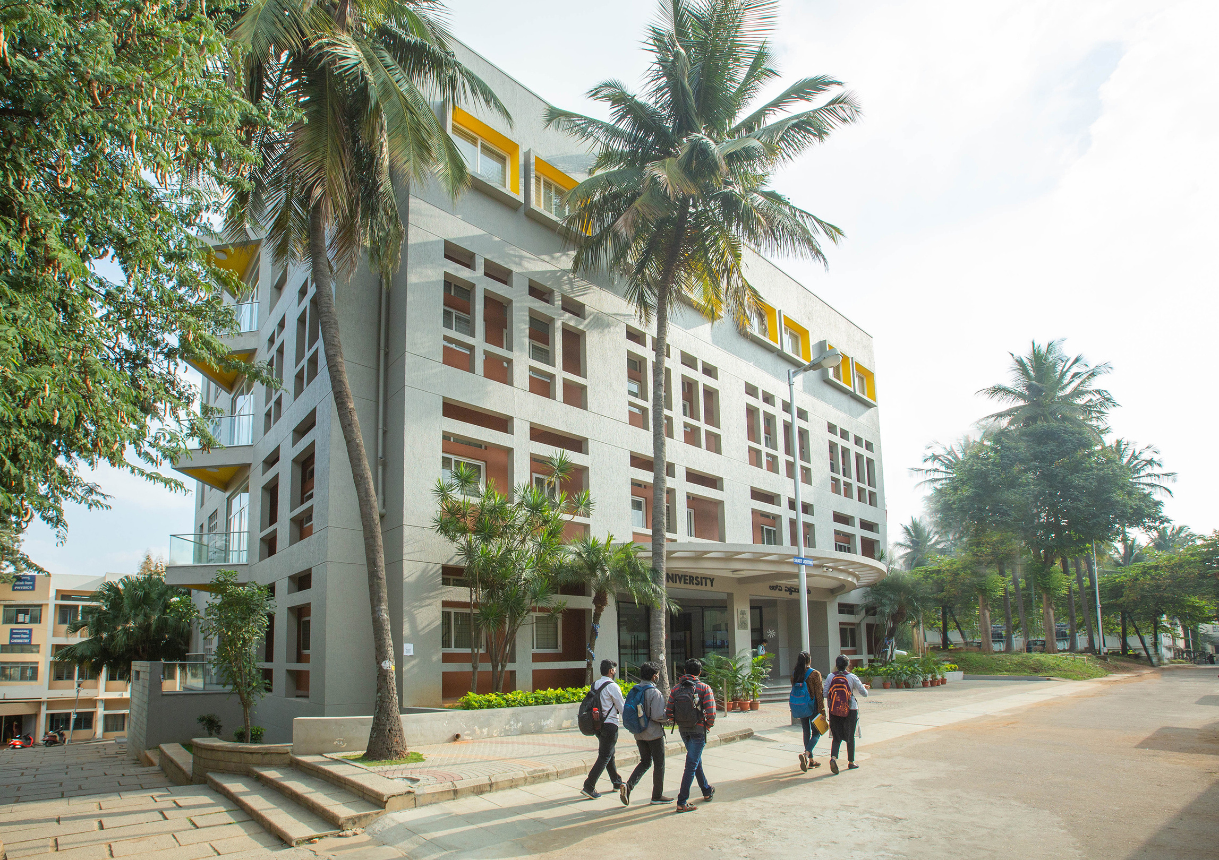

ADVANCED TOPICS IN GEN AI
CAMPUS VIEW - LLM Driven Visual Query System for Campus Facilities
ROHAN B - 1RVU22BSC082
GUNASHREE R - 1RVU22BSC032
CS4232
SEMESTER VII

Slide 2
CONTENTS
01
PROJECT OVERVIEW
02
INPUT AND OUTPUT
03
ARCHITECTURE STRUCTURE
04
MODELS AND API USED
05
DEMO USE CASES
06
CONCLUSION

Slide 3

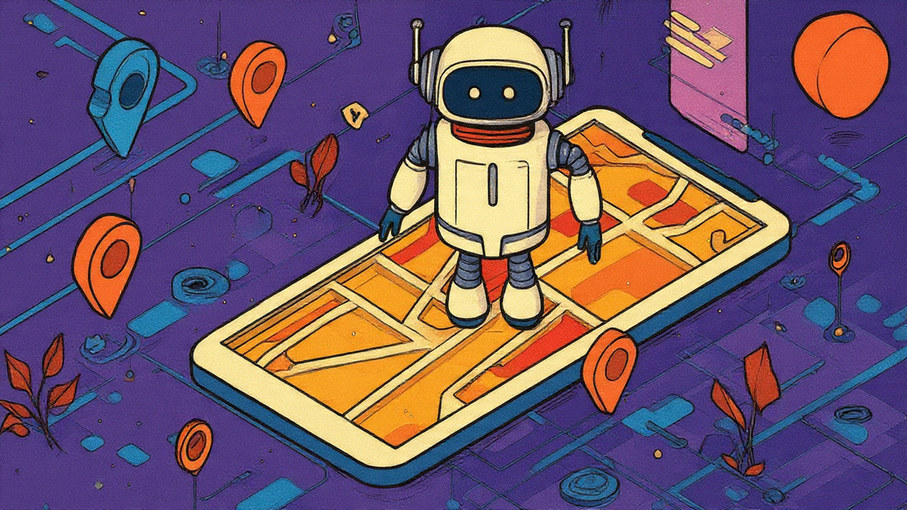
INTRODUCTION
CampusView
— Visual Campus Navigator is an AI-powered visual question-answering system that helps users identify and learn about various campus facilities through image-based queries. It uses Google’s Gemini 1.5 Flash, a multimodal large language model (LLM) capable of understanding both images and text. The system uniquely integrates model reasoning, RAG (Retrieval-Augmented Generation), and rule-based logic to provide accurate and context-aware responses. If the uploaded image does not belong to the campus, the model intelligently responds, “This doesn’t look like part of the campus,” ensuring robustness and reliability.

Slide 4

PROBLEM STATEMENT
Visitors, students, and staff often find it challenging to identify campus buildings or facilities just by appearance. Existing systems rely heavily on textual or GPS data, which limits their accessibility and interactivity. The challenge is to create an AI system that can:
KEY POINTS
Multimodal Reasoning: Understands both images and text queries.
RAG-based Retrieval: Fetches accurate facility data from structured local JSON.
Rule-based Logic: Ensures responses are restricted to known campus facilities.
Robust Integration: Combines LLM reasoning + custom data filtering + Gradio UI.
Edge-case Handling: Non-campus images trigger “This doesn’t look like part of the campus.”

Slide 5



INPUT & OUTPUT
Inputs
Multimodal Inputs: The system accepts both visual (image) and textual (query) data.
Image Input: The uploaded image (e.g., canteen.jpg, lab.jpg, gym.jpg)
Text Query Input: The user provides a natural language query.
The model combines vision-language understanding to identify the facility and retrieve relevant information.
Processing
The generated caption acts as a semantic key and is compared with a local knowledge base (JSON) using the RAG (Retrieval-Augmented Generation) technique.
The backend logic (Flask + Python) integrates model reasoning, RAG filtering, and custom rule-based validation to ensure accurate responses.
Output
Displays information such as facility name, timings, sections, and description.

Slide 6
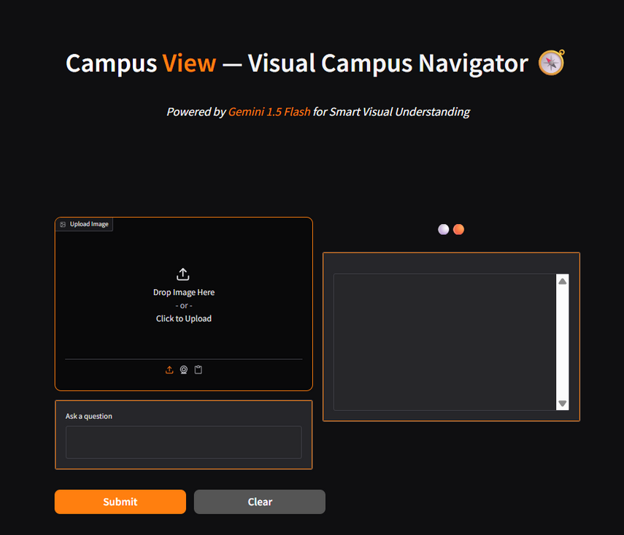
FRONTEND
The frontend is built using Gradio, which provides an interactive and user-friendly web interface.
Users can:
Upload an image of any campus facility.
Type a question (e.g., “What place is this?” or “When is it open?”).
The interface includes visually appealing design elements like a background image, colored borders, and custom buttons for submitting and clearing input.
Once the user submits a query, the image and question are sent to the backend for processing.
Example: When a user uploads a canteen photo and asks, “What is this place?”, the frontend passes both to the backend for inference.

Slide 7
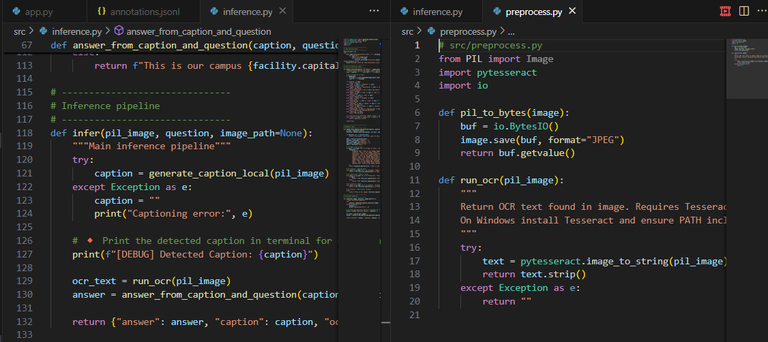
BACKEND
The backend is powered by Gemini 1.5 Flash integrated via API, along with a custom RAG (Retrieval-Augmented Generation) and rule-based logic system. The backend ensures accurate responses, handles edge cases, and integrates model reasoning, retrieval logic, and structured data seamlessly.

Slide 8
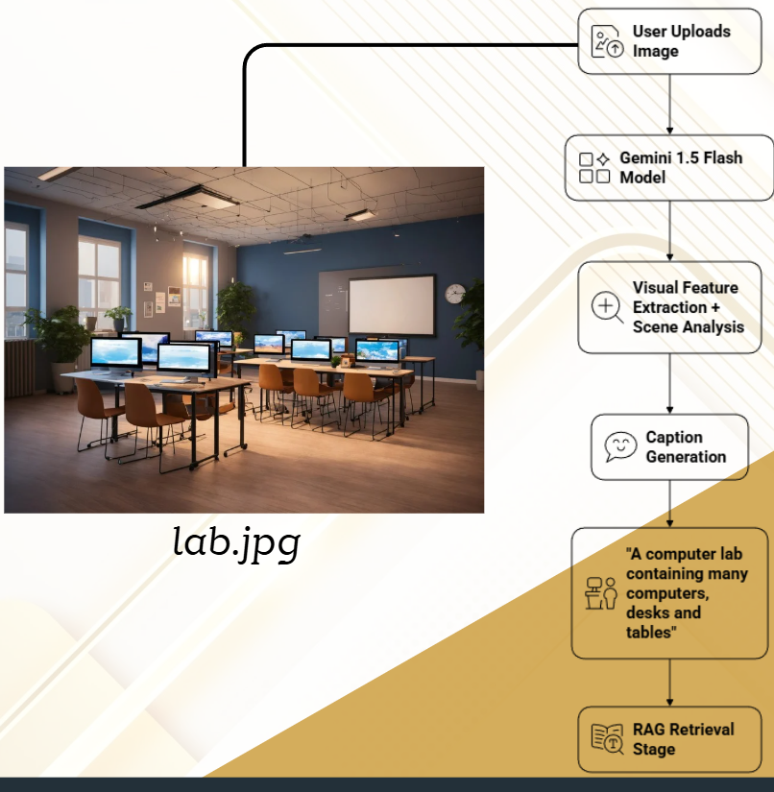
WORKFLOW
1. Image Understanding (Gemini 1.5 Flash)
The uploaded image is passed to the Gemini 1.5 Flash model, which performs multimodal reasoning to understand visual details. It extracts key objects, context, and scene semantics to generate a caption describing the image (e.g., “students eating food inside a canteen”). This caption serves as the input for the RAG retrieval stage to identify the facility.

Slide 9
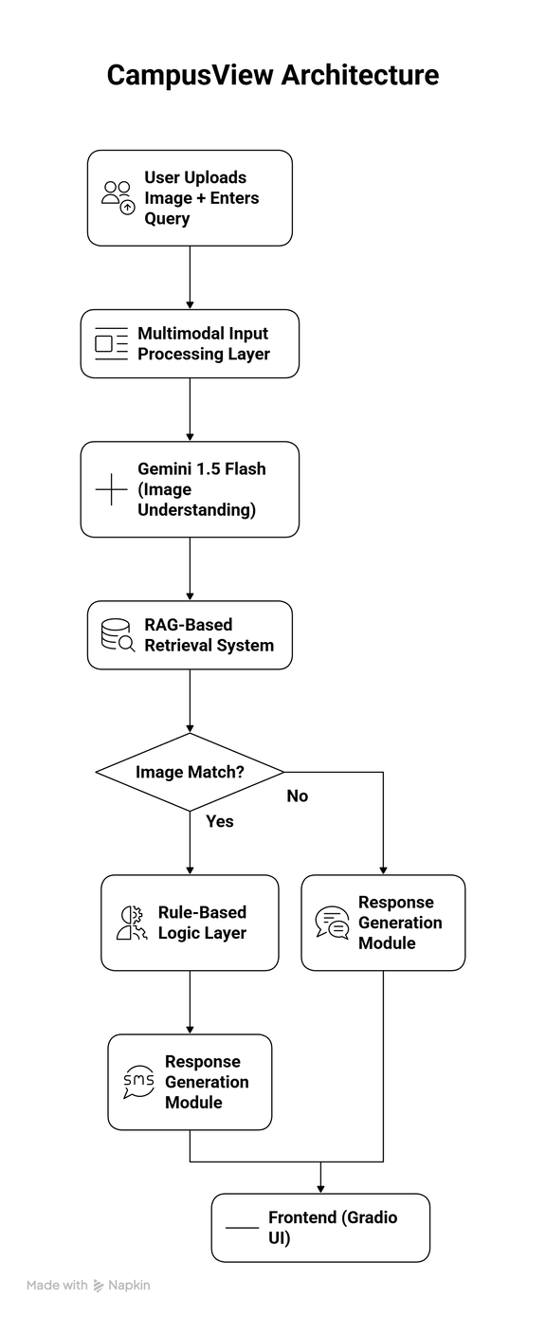
WORKFLOW
2. RAG-Based Retrieval
The generated caption is compared with a local JSON knowledge base containing details of known facilities (e.g., library, lab, gym). If a match is found, relevant details like timings, sections, and description are retrieved.
3. Rule-Based Logic
If the model’s caption doesn’t match any known facility or contains unrelated elements, the system outputs a safety message — “This doesn’t look like part of the campus.”

Slide 10
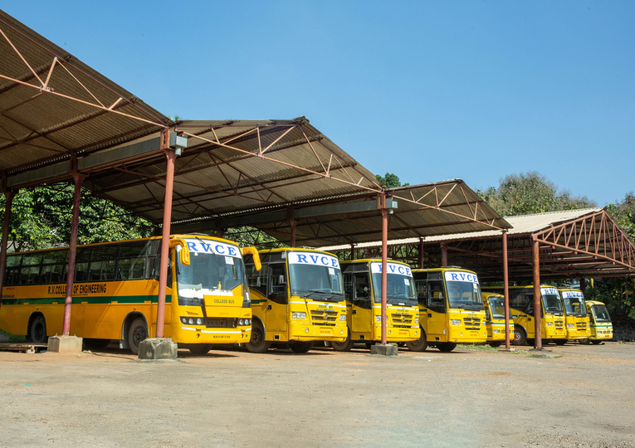
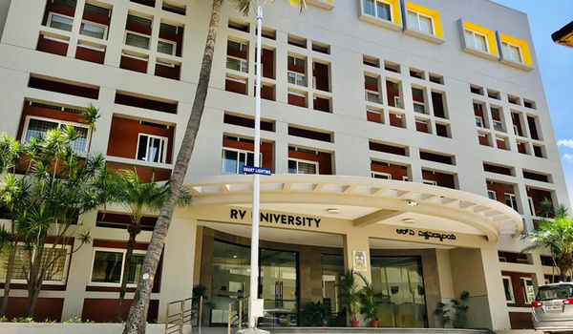
DEMO USE CASES
Case - I
Input: parkinglot.jpg
Query: What is this place
Response: This is the campus Parking Lot, offering secure parking spaces for student and staff vehicles with CCTV monitoring.
parkinglot.jpg
Case - II
Input: admission.jpg
Query: What are the facilities provided
Response: The Admission office includes: 4 help desks, online admission portal support
admission.jpg

Slide 11
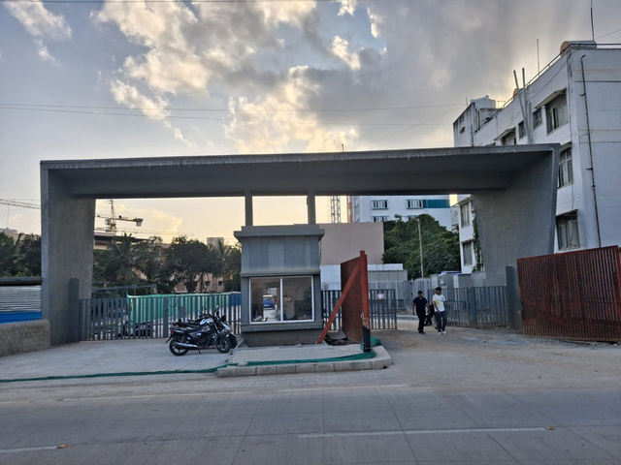
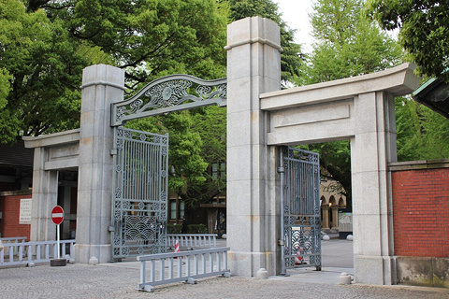
HANDLING EDGE CASES & ROBUSTNESS
Edge Case I - External Campus Images
When an image of the college back gate is uploaded, the model accurately identifies it using visual-semantic features extracted by Gemini 1.5 Flash. However, if an image of any other institution’s back gate is uploaded, the system intelligently rejects it with the response —
“This doesn’t look like a part of our college campus.”
backgate.jpg
IMAGE | QUERY | RESPONSE
backgate.jpg | What is this place? | This is our campus Back Gate, used as a secondary entrance and exit monitored by security and CCTV.
testbackgate.jpg | What is this place? | This doesnt look like a part of the college campus.
testbackgate.jpg

Slide 12
HANDLING EDGE CASES & ROBUSTNESS
Edge Case II - Context Aware Query Understanding
When users ask context-based queries such as “Where am I?” or “Where is this place?”, the system leverages LLM reasoning and semantic intent detection to differentiate between descriptive and locational queries.
For “Where am I?”, it responds with a description of the facility
(e.g., “You are at the Computer Lab, equipped with networked systems”).
For “Where is this place?”, it provides the location context within the campus
(e.g., “This lab is located in Block A, first floor”).
This showcases the model’s contextual understanding and ability to perform query disambiguation using natural language reasoning.
lab.jpg

Slide 13
MODELS AND API USED
APIs Used
Gemini 1.5 Flash (Google): For multimodal vision-language inference.
FastAPI: To handle web requests and integrate with Gradio.
Internal Modules
Inference Engine (inference.py): Handles image captioning, OCR, and RAG retrieval.
Rule-based Logic: Filters outputs outside known dataset.
Local JSON Knowledge Base: Stores details of facilities like timings, description, and location.

Slide 14




FUTURE ENHANCEMENT
Voice Interaction Integration
Implement speech-to-text and text-to-speech modules to enable natural audio-based communication for a more interactive user experience.
Campus Navigation Map
Integrate an interactive campus map that provides real-time location guidance and route visualization for location-based queries.
Expanded Facility Metadata
Include additional details such as “Person in Charge”, contact information, and facility capacity to enhance informational depth.
Mobile App Deployment
Extend the system into a mobile-friendly version for on-the-go accessibility and smoother user interaction.

Slide 15








RUBRICS CRITERIA
Unique use of LLM capabilities - Utilizes Gemini 1.5 Flash’s multimodal reasoning
Choice of LLMs - Gemini 1.5 Flash
Advanced LLM techniques - Multimodal inputs and reasoning, RAG based retrieval, Rule based filtering
Handling Edge cases - Tested
API’s Used - Gemini API (External) and FAST API (Internal)
Cloud Host - Hugging Face
Github - Campus View
Documentation - Github

Slide 16
CONCLUSION
CampusView demonstrates the integration of multimodal AI by combining image understanding and natural language processing through Gemini 1.5 Flash. Using RAG-based retrieval and custom rule-based logic, the system accurately identifies campus facilities, retrieves contextual data, and handles edge cases effectively. Its modular design, seamless frontend–backend communication, and scalable architecture highlight the potential of LLM-powered visual understanding systems. With planned enhancements such as audio interaction, interactive campus mapping, and expanded data coverage, CampusView sets a foundation for intelligent, real-time campus navigation and information assistance.

Slide 17
THANK YOU

